Slide 1
Joseph LoCascio, 111, M.D.
HIMG
Huntington, WV

Slide 2
Femtosecond Laser was initially meet with huge optimism about the promise its technology promised.
Femtosecond laser assisted cataract surgery uses a femto laser to generate free electron and ionized molecules, which in turn produce photo-disruption and photoionization of optically transparent tissue through an acoustic shock wave which is femto unique because of its shorter pulse time relative to other ophthalmic lasers. Theoretically lasers with shorter pulse times are able to reduce energy output significantly for a given effect, thereby reducing collateral damage to ocular tissues.
This was immediately tempered by the cost of the systems and the initial lack of reimbursement.

Slide 3
Steve Slade met with CMS and CMS said can use it with premium iol surgeries because of the imaging
Features associated with the lasers.
Keep in mind most of the FLACS cases in the studies almost always had a sever selection bias. The laser was only used when the patient could pay for it. There were contraindications to FLACS: small pupils, cloudy corneas, lasik interface fluid
Circularity of capsulotomies have small to no influence on ELF and thus refractive results

Slide 4
Anterior Capsulotomy Integrity after
Femtosecond Laser...Assisted Cataract Surgery
Robin G. Abell , M BBS , ¹ Peter E .] . Davies , FRANZC0 ,¹ David Phelan , BSc ,³ Karsten Goemann, PhD ,⁴ Zachary E. McPherson , BMedSci ,² Brendan ]. Vote , FRANZC0 1
Objective: To compare the incidence of anterior capsular tears after femtosecond laser-assisted cataract surgery (FLACS) versus phacoemulsification cataract surgery (PCS) and to assess the ultrastructural features of anterior capsulotomy specimens (FLACS and PCS) using electron microscopy.
Conclusions: Laser anterior capsulotomy integrity seems to be compromised by postage-stamp perforations and additional aberrant pulses, possibly because of fixational eye movements. This can lead to an increased rate of anterior capsule tears, and extra care should be taken during surgery after femtosecond laser pretreatment has been performed. A learning curve may account for some of the increased complication rate with FLACS. However, the SEM features raise safety concerns for capsular integrity after FLACS and warrant further investigation.
Ophthalmology 2013;.:1-8 © 2013 by the American Academy of Ophthalmology.

Slide 5
2013
A 1626 patients: Anterior capsular tears occurred 15/804 FLACS (1.87%) vs 1/822 PCS (0.12%)
B. 7 cases of anterior capsular tears in FLACS extended posteriorly

Slide 6
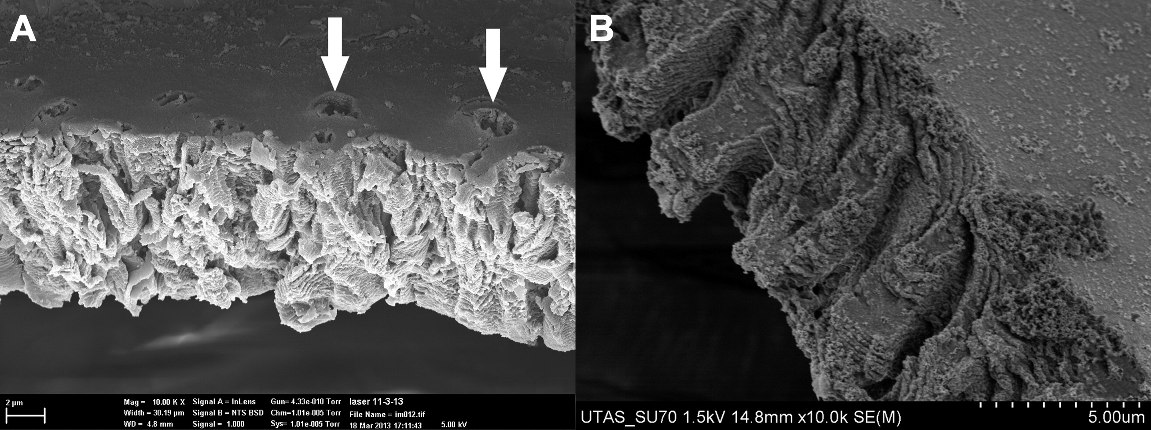

Figure 2
A, Irregular structure of the capsule edge from the Catalys femtosecond laser (OptiMedica, Sunnyvale, CA). Note also the apparently misplaced laser pulses (white arrows) on the smooth surface of the anterior capsule measuring less than 2 μm across (original magnification, ×10 000). B, Similar structure at the same magnification of the capsule edge from the LensAR laser (original magnification, ×10 000).
Notes:
A, Irregular structure of the capsule edge from the Catalys femtosecond laser (OptiMedica, Sunnyvale, CA). Note also the apparently misplaced laser pulses (white arrows) on the smooth surface of the anterior capsule measuring less than 2 μm across (original magnification, ×10 000). B, Similar structure at the same magnification of the capsule edge from the LensAR laser (original magnification, ×10 000).

Slide 7
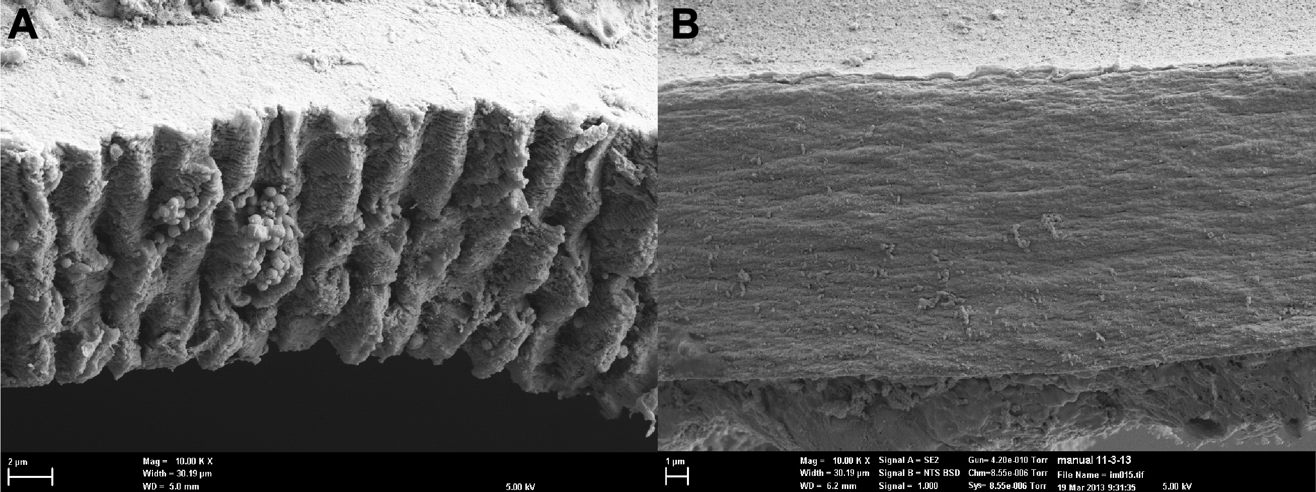
Figure 4
A, Edge treated with the Catalys femtosecond laser (OptiMedica, Sunnyvale, CA) is serrated, resembling a micro–can-opener structure from the laser photodisruption, each estimated here to be just less than 2 μm across (original magnification, ×10 000). B, Manually torn capsule (original magnification, ×10 000).
Notes:
A, Edge treated with the Catalys femtosecond laser (OptiMedica, Sunnyvale, CA) is serrated, resembling a micro–can-opener structure from the laser photodisruption, each estimated here to be just less than 2 μm across (original magnification, ×10 000). B, Manually torn capsule (original magnification, ×10 000).

Slide 8
Femtosecond laser-assisted cataract surgery versus standard phacoemulsification cataract surgery: Outcomes and safety in more than 4000 cases at a single center
Robin G. Abell, MB BS, Erica Darian-Smith, Jeffrey B. Kan, MB BS, Penelope L. Allen, PhD, Shaun Y.P. Ewe, MB BS, Brendan J. Vote, FRANZCO
Purpose: To compare the intraoperative complications and safety of femtosecond laser-assisted cataract surgery and conventional phacoemulsification cataract surgery.
Conclusions: Significant intraoperative complications likely to affect refractive outcomes and patient satisfaction were low overall. The 2 cataract surgery techniques appear to be equally safe. Although anterior capsule tears remain a concern, the safety of femtosecond-assisted cataract surgery in terms of posterior capsule complications was equal to that of phacoemulsification.
J Cataract Refract Surg 2014; •:•-• © 2014 ASCRS and ESCRS

Slide 9
2014
4000 cases capsular problems :incomplete cap 21 FLACS n/a
PCS, anterior cap tags FLACS 30 pcs 1, anterior cap tear flacs 34 pcs 5, posterior cap tear FLACS 8 pcs 4 , corneal haze FLACS 12 pcs 1 , unstable pupil FLACS 30 pcs 14, need for hooks FLACS 5 pcs 1.

Slide 10
Cystoid macular edema after femtosecond laser-assisted versus phacoemulsification cataract surgery
Shaun Y.P. Ewe, MBBS, Carmen L. Oakley, MBBS, Robin G. Abell, MBBS, Penelope L. Allen, PhD, Brendan J. Vote, FRANZCO
Purpose: To evaluate the incidence of postoperative clinical cystoid macular edema (CME) asso­ciated with femtosecond laser-assisted cataract surgery (Catalys laser system) versus phacoemul­sification cataract surgery.
Conclusion: Increased CME might be a subthreshold retinal injury safety signal after femto­second laser pretreatment and warrants further study.
J Cataract Refract Surg 2015; 41:2373-2378 © 2015 ASCRS and ESCRS

Slide 11
2015
833 eyes had FLACS and 458 had PCS
FLACS 7 vs PCS 1 case of CME

Slide 12
A Comparative Cohort Study of Visual Outcomes in Femtosecond Laser--Assisted versus Phacoemulsification Cataract Surgery
Shaun Y.P . Ewe , MBBS , Robin G . Abell , M BBS , Carmen L. Oakley , MBBS, Chris H.L. Lim, MBBS, Penelope L. Allen , PhD , Zachary E. McPherson , BMedSci, Anupam Rao , MBBS, Peter E .J. Davies , FRANZCO, Brendan J. Vote , FRANZCO
Purpose: To evaluate visual outcomes after femtosecond laser-assisted cataract surgery (LCS) with phacoemulsification cataract surgery (PCS).
Conclusions: Femtosecond LCS did not demonstrate clinically meaningful improvements in visual outcomes over conventional PCS.
Ophthalmology 2015;.:1-5 © 2015 by the American Academy of Ophthalmology.

Slide 13
2015
1876 pts: 988 FLACS, 888 PCS
Po bcva after FLACs better 20/30 (89.7% vs 84.2), 20/40 (96.6 vs 93.9)
PCS had more letters gained (13.5 vs 12.5 FLACS)
Both reflect healthier and better VA to start with FLACS

Slide 14
Efficacy and Safety of Femtosecond Laser-Assisted Cataract Surgery Compared with Manual Cataract Surgery
A Meta Analysis of 14567 Eyes
Marko Popovic , M D(C ) , Xavier Campos-Moller , M D ,Matthew B. Schlenker , MD,2·Iqbal Ike K . Ahmed , MD, FRCSC
Topic: To investigate the efficacy and safety of femtosecond laser-assisted cataract surgery (FLACS) relative to manual cataract surgery (MCS).
Clinical Relevance: It is unclear whether FLACS is more efficacious and safe relative to MCS.
Conclusions: There were no statistically significant differences detected between FLACS and MCS in terms of patient-important visual and refractive outcomes and overall complications. Although FLACS did show a statistically significant difference for several secondary surgical outcomes, it was associated with higher prostaglandin concentrations and higher rates of posterior capsular tears.
Ophthalmology 2016;•: 1-14 © 2016 by the American Academy of Ophthalmology.

Slide 15
2016
Visual and refractive outcomes- FLACS vs PCS - no significant differences
Procedure time, BSS volume- no significant differences
Capsulotomy and casulorrhexis parameters- method dependent FLACS produced capsulotomies that were significantly closer to intended diameters and less horizontal decentrations.
Central corneal thickness was 6.37 microns thinner in FLACS and endothelial cell count reduction was not significantly different but 55.45 fewer cell with PCS.
Prostaglandin concentration was higher with FLACS vs PCS
Safety analysis Eyes that underwent PCS had a significantly lower incidence of posterior capsular tears. Other complications: corneal complications, pupillary complications were insignificantly different.

Slide 16
Femtosecond laser-assisted cataract surgery versus standard phacoemulsif ication cataract surgery: Study from the European Registry of Quality Outcomes for Cataract and Refractive Surgery
Sonia Manning, MD, FRCSl(Ophth), Peter Barry, FRCS, FRCOphtht, Ype Henry, MD, FEBO, Paul Rosen, FRCS, FRCOphth, Ulf Stenevi, MD, PhD, David Young, PhD, Mats Lundstrom, MD, PhD
Purpose: To compare the visual, refractive, and adverse outcomes of femtosecond laser-assisted cataract surgery and conventional phacoemulsification cataract surgery.
Conclusions: Femtosecond laser-assisted cataract surgery did not yield better visual or refrac­tive outcomes than conventional phacoemulsification cataract surgery. Intraoperative complica­tions were similar and low in both groups. Postoperative complications were lower in conventional phacoemulsification cataract surgery.
J Cataract Refract Surg 2016; 42: 1779-1790 © 2016 ASCRS and ESCRS

Slide 17
2016
2814 FLACS vs. PCS 4987
Posterior capsular complications - 0.7% vs 0.4%
postoperative CDVA 0.05(6/6) vs 0.03(6/6)
worse post operative CDVA ( by 5 letters or more) 1.0 % vs. 0.4%
CDVA 0.3 (6/12) or better, 96.3% vs. 97.1%
post operative complications – 3.4% vs 2.3%

Slide 18
Financial modelling of femtosecond laser-assisted cataract surgery within the National Health Service using a 'hub and spoke' model for the delivery of high-volume cataract surgery
H W Roberts, M Z Ni, D P S O'Brart
Aims: To develop financial models which offset additional costs associated with femtosecond laser (FL)-assisted cataract surgery (FLACS) against improvements in productivity and to determine important factors relating to its implementation into the National Health Service (NHS).
Conclusions: The financial viability of FLACS within the NHS is currently precluded by the cost of the Pl and the lack of knowledge regarding any gains in operational efficiency.
BMJ Open 2017; 7:e013616. doi:10.1136/bmjopen-2016-013616

Slide 19
2017
935 pts, FLACS 502 vs PCS 433 Outcomes were assumed to be equivalent.
The financial viability of FLACS within the NHS is currently precluded by the cost Of the PI and any gains in operations FLACS 14% higher than PCS.
If FLAC becomes adopted in the UK then TECHNICIANS may be trained to perform the laser part of the procedure at reduced cost.

Slide 20
lntraindividual comparison between femtosecond laser-assisted and conventional cataract surgery
Anna S. Mursch-Edlmayr, MD, Matthias Bolz, MD, Nikolaus Luft, MD, Michael Ring, PhD, Thomas Kreutzer, MD, Christoph Ortner, MD, Matthias Rohleder, MD, Siegfried G. Priglinger, MD
Purpose: To compare the safety and efficacy between femto­second laser-assisted cataract surgery using the Victus laser sys­tem and conventional cataract surgery.
Conclusion: Femtosecond laser-assisted and conventional cataract surgery using the mentioned system were equally safe and effective.
J Cataract Refract Surg 2017; 43:215-222 © 2017 ASCRS and ESCRS

Slide 21
2017
50 pts.
FLACS surgery time was statistically significantly longer than PCS
FLACS pts had more incomplete capsulotomies
FLACS pts had more subconjunctival hemorrhages with laser (57.5% with laser vs.2.1 % with manual)
Pts had more pain with FLACS (63.8% pts reported they had more pain with FLACS than PCS)
Pts preferred manual over FLACS. 57.4%

Slide 22
Incisional Astigmatism correction
Laser is more precise and consistent in architecture of incision
Titratable effect possible - Open incision selectively
Each surgeon has to develop their own nomogram- Doonenfeld for Laser LRI use 8 mm oz at 33% reduction of his nomogram at 85% depth of pachymetry

Slide 23
