Slide 1

Time Management

Slide 2
Disclosures:
Craig N. Piso is founder and President

Slide 3

Isaac Newton’s First Law of Motion:
“An object at rest stays at rest and an object in motion stays in motion with the same speed and in the same direction unless acted upon by an unbalanced force.”

Slide 4

Put First Things First
If there is one message to glean from this wisdom, it is that a meaningful life is not a matter of speed or efficiency. It’s much more a matter of what you do and why you do it, than how fast you get it done.
Stephen R. Covey

Slide 5
Planning for Success
Visualize results
Mental rehearsal = achievement
Short- & long-term planning
Hope & energy relationship

Slide 6

Be Proactive
Internal control
Be the wind, not a weather vane
Independent spirit
Power/Responsibility
Lead change & drive results

Slide 7
What You Focus Upon Tends To Expand
Visualize goals – stay focused
Persevere –
be resilient
Importance & Confidence!

Slide 8
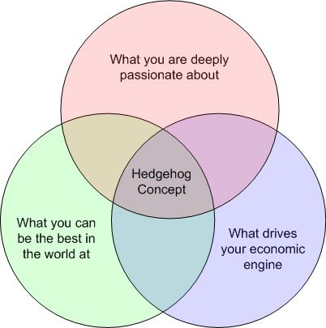
Power of Focus
Intersection of 3 Circles:
The Hedgehog Concept
Tortoise and the Hare
Culture of Discipline

Slide 9
Learn to Prioritize
Importance vs. Urgency
“80/20 Rule”
Get scheduled
Plan your work & work your plan
Get maximum ROI

Slide 10

Time Management Quadrant
“Important and Urgent”
“Urgent, but not Important”
“Important, but not Urgent”
“Not Important and not Urgent”

Slide 11
Power of Excellent Thought
Unwavering faith
to prevail – hopeful
Reframing adversity as opportunity
Confronting the brutal facts – no denial
Self-fulfilling prophecy

Slide 12
Take Care of Yourself
Maintain & improve your critical work tools
Good steward of mind, body, & spirit
Plan time to review
& integrate self – “Sharpen the saw”

Slide 13

Empowerment:
Plan Your Work…Then Work Your Plan
Explore menu of options
Model other successes without copying them
Set SMART goals
Plan small steps
Build optimism & support with freedom to consider Plan B if necessary

Slide 14

Empowerment:
Putting Your Plans into Action
Identify your first action step
Monitor & measure progress
Use supports & accountability partners to face all truths
Fail forward after any setbacks or missteps
Reload…take another shot

Slide 15
Applied Skills
Write down &
share your goals
Describe how you’ll be as a successful person & the life you’ll create/live
Take steps NOW!

Slide 16

Question & Answer

