Slide 1
Vision, public safety, and the DMV
Edwin Wortham V, M.D.
WVAEPS/PAO Scientific Conference
April 28, 2017
Notes:
I want to share a story and start a conversation with you.
This is a tragic story about a young woman, a driver with stated and known poor vision, and public safety in our combined adjacent states…Virginia, WVA, and PA.
My goal this morning is to raise your awareness that many of our patients, those for whom we have studied and trained and labor over to improve their vision, are driving, but because of their compromised vision, should not be driving. And, I'd like to propose some changes to the DMV.

Slide 2
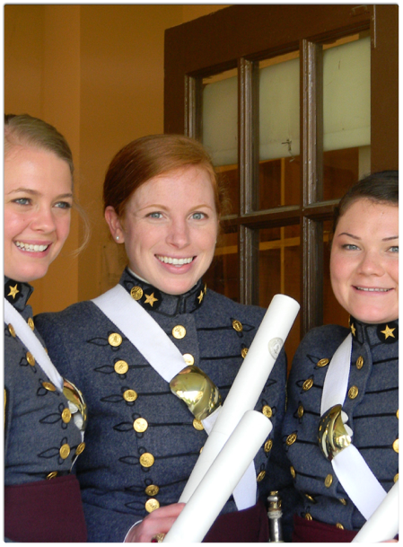
VMI
S-2 captain, pole vaulter, cincinnatus award recipient, Rhodes scholar finalist, top gpa
Notes:
The young woman in this story was an accomplished athlete, a college pole vaulter, a scholar, and by all counts, incredibly driven to serve and make a difference in the world around her. As a top VMI cadet and graduate, she knew what she wanted in life and went for it with all the gusto that a driven and talented young woman could employ.

Slide 3
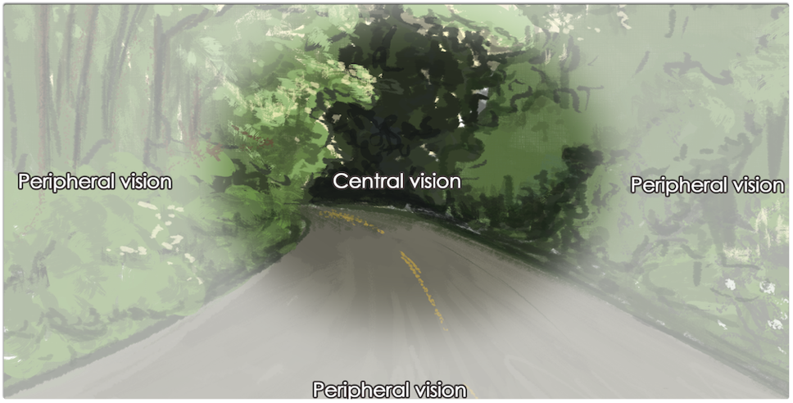
Driver
Marginal vision but determined to drive
Notes:
The driver in this story, like many we see in our practices, was blind in one eye, had marginal vision in his only eye from diabetic retinopathy and pan retinal laser, and like so many drivers, was willing to drive and risk injury to himself and others despite his visual handicaps. In his own words, according to police investigators, "I'd rather die than lose my right to drive". He said that he could only see 10-20 feet in front of his car and that he scans the lines, from right to left, back and forth, to stay in the lane.

Slide 4
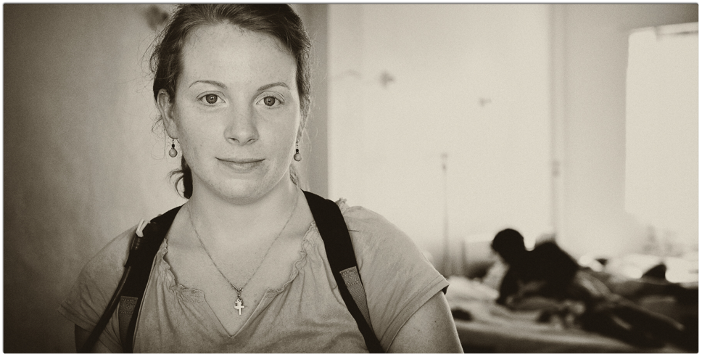
September 5, 2015
Cycling while training for a marathon...on a country road…an unintended meeting
Notes:
Like so many preventable tragedies, there was an unintended meeting, an unplanned life altering event, that under most circumstances would never have occurred. These two people met on a country road on a Saturday morning in September 2015. The young woman went out on a long bike ride ostensibly to cross train for an upcoming marathon, and the driver, off for a friendly visit driving at speed on a busy country road.
He says he didn't see her, and in fact kept driving for a distance, then pulled over to a fire station where he was told that he had hit someone on a bicycle. The R front bumper of the driver's car had sent her on a 150 ft trajectory that left her with massive head and chest injuries, and no breath or life left in her.
Marginal vision in only one eye, brittle diabetes, diabetic retinopathy, a man not ever wanting to lose his right to drive, and meeting a young woman on a country road. He had his driver's license suspended, she lost her promising life in a preventable tragic accident.
Preventable I said.
How so you might ask?

Slide 5
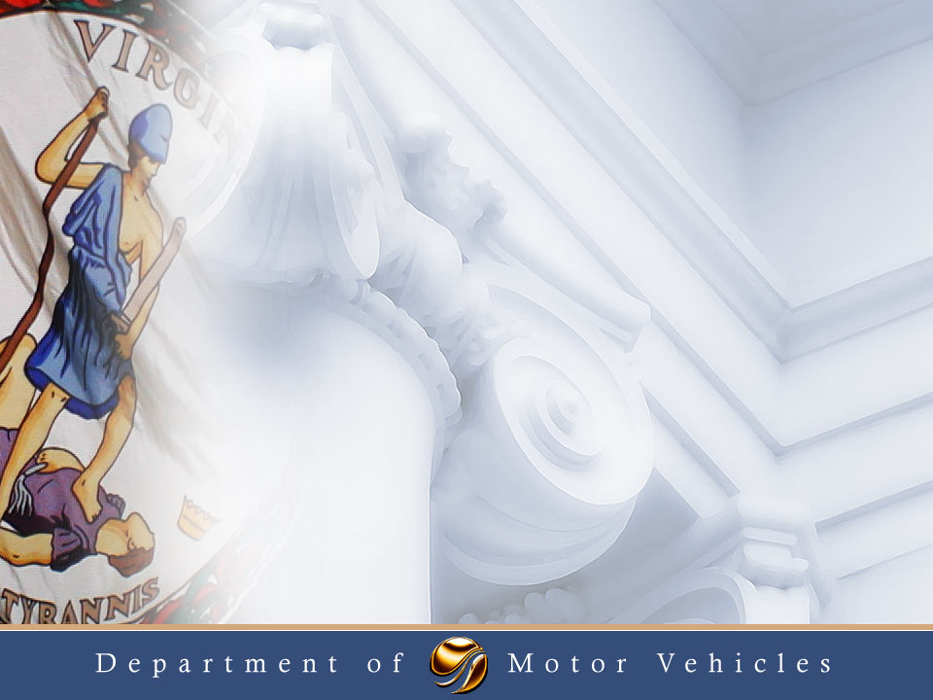
Vision Standards for the Virginia Driver
Notes:
There are clear vision regulations on the books in Virginia, as there are in your two states . Shamefully, until recently, I could not have fully articulated all these parameters clearly if asked.
I’m here to raise your awareness that these standards may not be enough to ensure our public safety!
And, I'd like to compel you, as the keepers of visual health in our respective states, that we need to take more responsibility to help keep our roads safe!

Slide 6
Vision Standards: The Regular Driver
The vision code is 46.2 – 311
20/40 or better corrected or uncorrected in one or both eyes
Horizontal visual field of at least 100 (now 110) degrees in one or both eyes
If one eye has an acuity worse than 20/200 then the field of vision is only considered for the eye meeting acuity standards
Notes:
To begin, here is a brief summary of the vision code in Virginia…not too unlike those in your states.
For day and night driving…a so called unrestricted license,
20/40 vision and at least 110 degrees of horizontal visual field is required.
Just recently we lobbied for changes to the Visual Field minimum standard and won this incremental upgrade to 110 degrees minimum .

Slide 7
Vision Standards: The Regular Driver
A restricted license may be issued to an individual with an acuity of 20/70 corrected or uncorrected in one or both eyes
A visual field of 70 degrees or better is required for this restriction
Daylight only – ½ hour after sunrise and ½ hour before sunset
The field of vision must be at least 40 temporally and 30 degrees nasally in the eye meeting the 20/70 standard
Notes:
If vision is at least 20/70, but not reaching 20/40, daytime only driving is allowed, assuming at least 70 degrees of horizontal VF, and that being 40 degrees temporally and 30 degrees nasally.
There are of course commercial regulations that I will not touch on just now.

Slide 8
Understanding the Public Health Challenge
We all lose functional abilities needed to drive safely – vision, mental sharpness, physical strength and flexibility – as we age, but at dramatically different rates; some individuals in their 70’s and 80’s are as fit as others in their 50’s and 60’s.
NHTSA estimates that on average a person is unable to drive for 8 years at the end of their lifespan.
DMV is mandated to ensure that those licensed in Virginia are medically fit to drive.
Chronic and acute conditions are handled differently
Notes:
In Virginia, the DMV is tasked with setting driving standards and enforcing those standards. There is a medical advisory committee at the DMV that reviews the health guidelines affecting driving and advises the commissioner as to needed changes in regulations. They also investigate high risk drivers who are reported to them from concerned citizens or from healthcare providers.

Slide 9
Association between Glaucoma and At-fault Motor Vehicle Collision Involvement among Older Drivers
Kwon M, Huisingh C, Rhodes L, McGwin G, Wood J, Owsley C. Ophthalmology. 2016;123:109-116
Notes:
One can debate the merits and parameters of our vision standards in our respective states. The literature fuels such a debate and it would be the case in any state, and in any nation, but these standards are our current law. Not surprising, there are some states that have more stringent regulations and others with very few. In fact, Alabama has no visual field requirement. Interestingly, and because of that, Alabama has fostered some extensive research and data collection on the impact of vision and visual fields on driving.
This recent population-based study of 2000 drivers shows that older drivers with glaucoma are more likely to have a history of at-fault motor vehicle collisions compared to those without glaucoma, to the tune of nearly 2 times a higher rate. Impairment in the horizontal visual field of these drivers revealed an independent association with at-fault MVCs, whereas visual acuity and contrast sensitivity impairment did not. Those with severe visual field loss had a significantly higher rate of at-fault MVC.
There are many other studies with similar results. However, we do not have consensus among our own colleagues regarding the implications of these studies as they might pertain to driving standards. This goes to the heart of the issue…legislators are more likely to listen to sound data and clear evidence, if indeed we can put them all together!

Slide 10
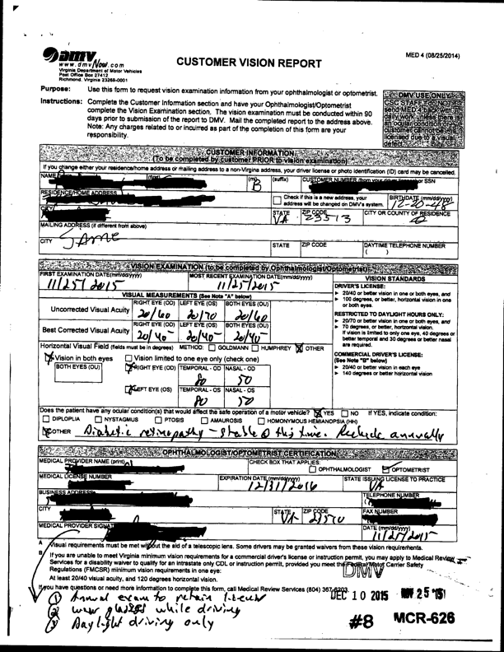
Notes:
Standards aside, there are still the roles of the eye care professional and the DMV to consider.
To emphasize the level of difficulty the DMV faces with cases that are sent to them for investigation , and the many ways Virginia drivers can slip through the cracks, I’d like to present this recent case.
This is the standard vision form filled out by eye docs, including optometrists. This patient, on the face of things, would pass muster and obtain an unrestricted license…adequate central vision and adequate visual fields .
But, thanks to an astute DMV nurse in Virginia, acting as their medical reviewer, she requested formal visual fields after reading the "other" and the diabetic retinopathy notation.
Note the 80/50 degree VF split in each eye. Once again, meets the state standard.

Slide 11
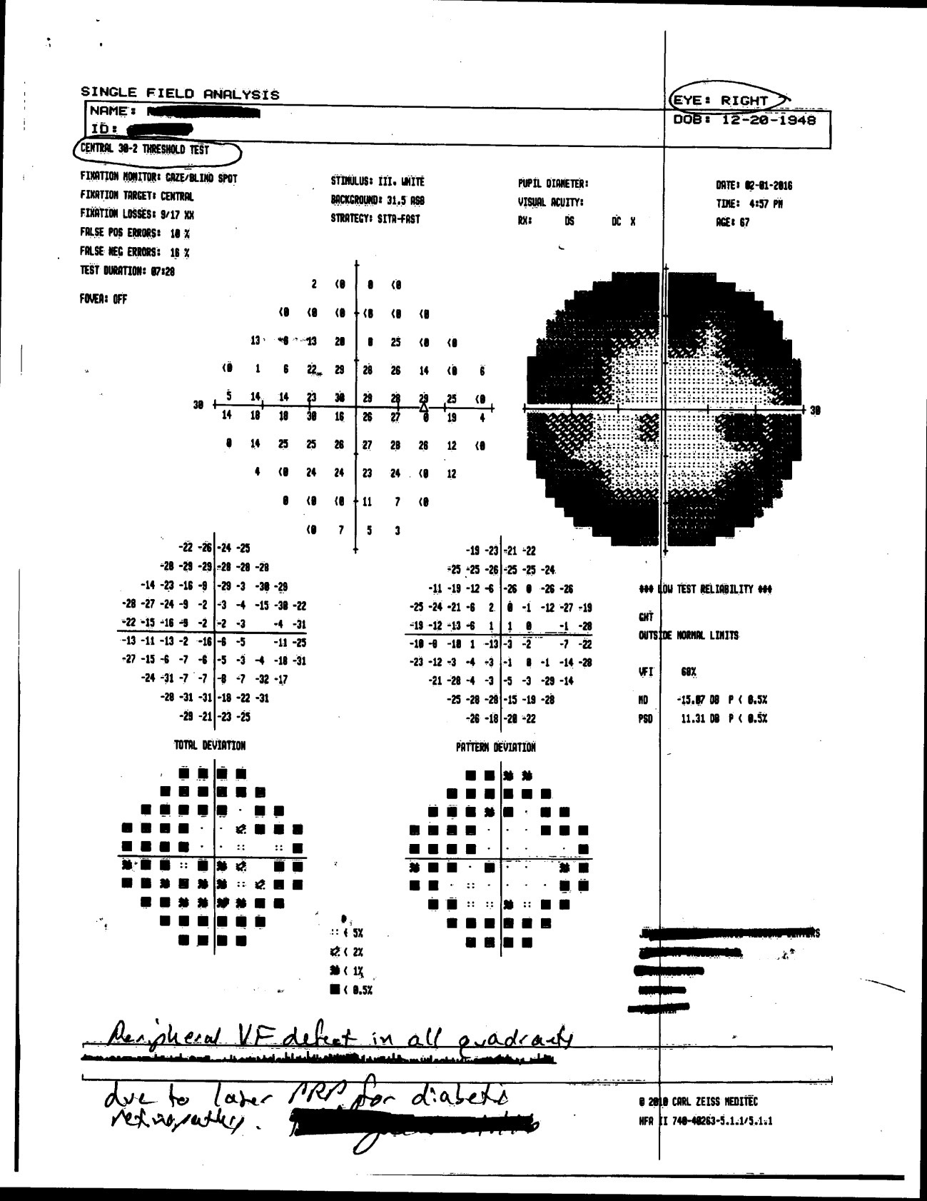
Notes:
Two months later, this 30-2 of the R eye in this same patient was sent to the nurse reviewer.
Clearly barely 15 degrees nasally and temporally is present in this eye, nowhere near the reported 80/40 visual field.

Slide 12
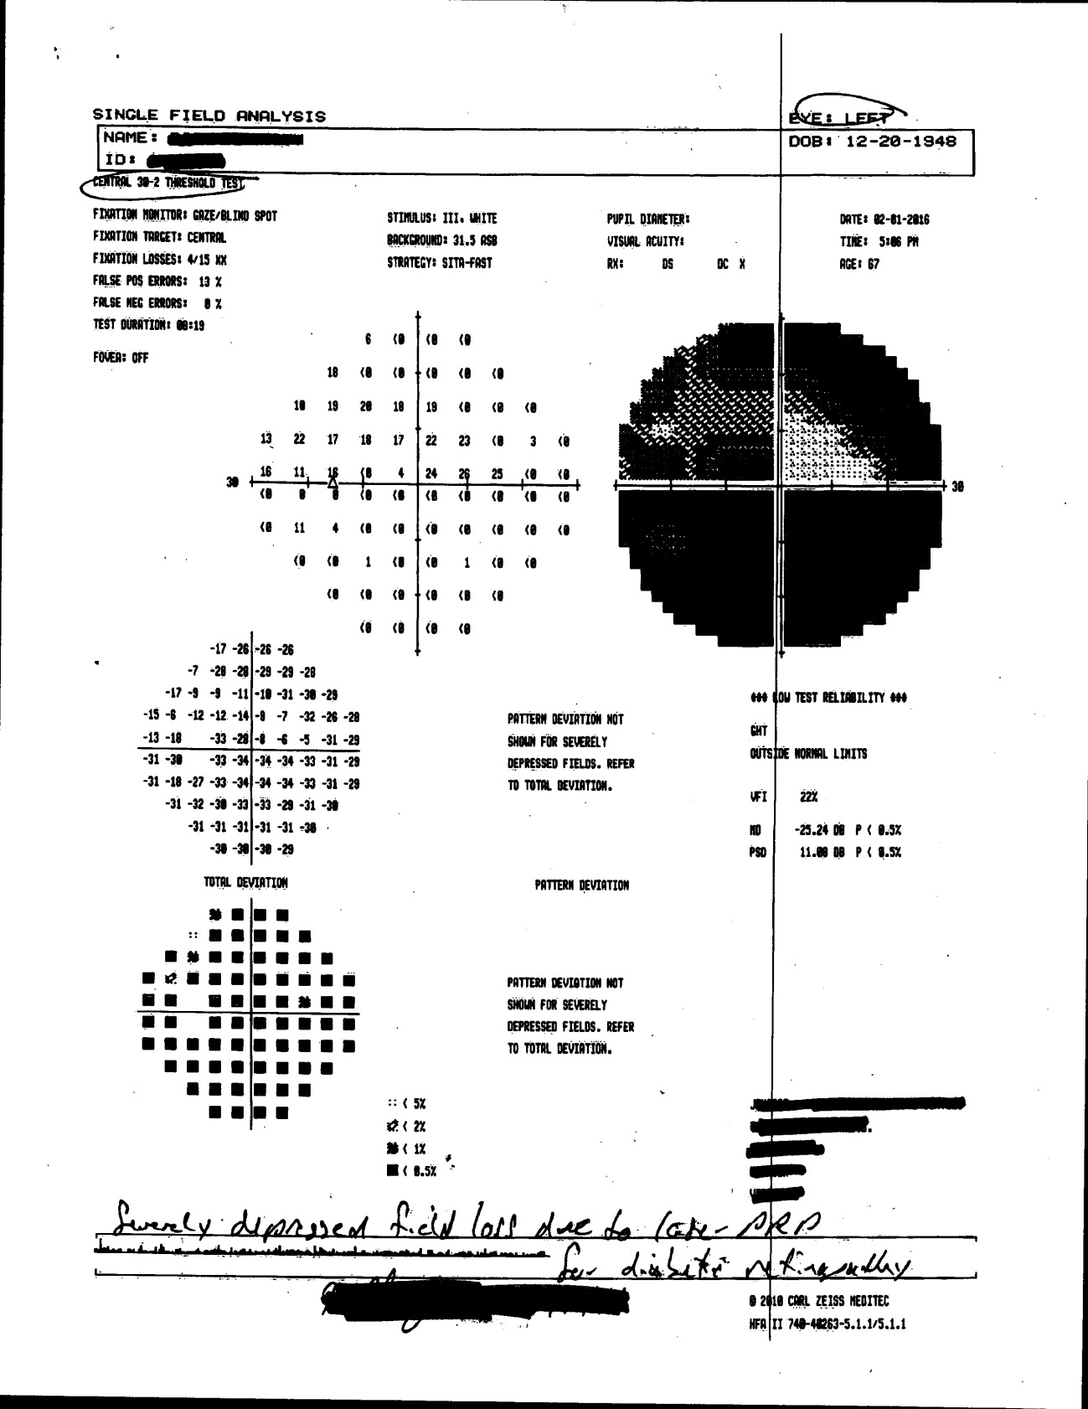
Notes:
And this L eye is even worse.
And can you imagine the navigation challenges and the risks to others while driving with a combined VF of little more than 15 degrees?
And this patient would have remained on the road were it not for the formal visual field as requested by the DMV.

Slide 13
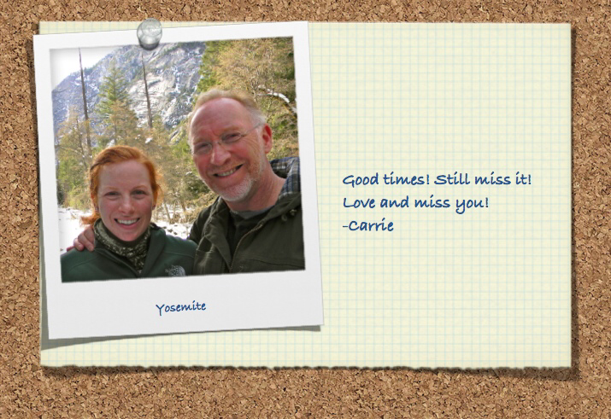
Notes:
I now want to come back to my story of the persons involved. I do not know the driver personally, though I know his vision was significantly compromised. By my own review of the visual field from his only eye obtained shortly after the accident, this driver would not have passed the Virginia DMV criteria. Thankfully, his license is now permanently revoked . Indeed, his life has been changed forever.
The young woman, Carrie, is my daughter. She has lost the most. And we have lost her. As her parent, I have joined a club I never wanted to join and am now a lifetime member that I cannot leave. Some of you might also be members of such a club, and I deeply empathize with you. Those of us losing a child would never wish such a loss upon another.

Slide 14
Chronic Health Conditions
DMV strives to identify individuals with chronic health conditions including progressive health conditions of the eye
DMV monitors individuals to determine at what point driving should be discontinued

Slide 15
Acute Medical Events
Acute medical events happen without warning
DMV is interested in identifying individuals with underlying conditions that may lead to an acute event
DMV uses predictive risk to make determinations on safety to drive

Slide 16
The Vision Code: Commercial Drivers
20/40 or better corrected or uncorrected
140 degree horizontal vision
This is also the vision standard for FMCSA (Federal Motor Carrier Safety Administration)

Slide 17
The Commercial Driver Vision Waiver
Commercial drivers who are otherwise qualified may apply for a vision waiver from the FMCSA if they do not meet the vision standard
Must submit a visual field analysis to 120 degrees in each eye.
Approval requires 20/40 corrected or uncorrected in the better eye with a 70 field of vision in each eye

Slide 18
The Commercial Driver Waiver: Virginia Only
Certain drivers are not subject to the FMCSA regulations (government entities, farm vehicles, bee keepers, etc.)
These drivers must apply for a vision waiver from the Virginia Department of Motor Vehicles
The Medical Advisory Board provides guidance on the Virginia standard
Virginia requires 20/40 or better corrected or uncorrected in the better eye and a 70 degree field of vision in each eye.
Virginia requires a total visual field of at least 120 degrees without defect whether the vision is monocular or binocular
Alzheimer’s Assn (2001). When to Yield: Questions & answers about dementia and driving.

Slide 19
Visual Field Policy
Developed by the Medical Advisory Board
Addresses visual field defects
Hemianopic defects may not drive. This includes hemianopia and quadrantanopia
Drivers must supply a visual field analysis on request
The visual field analysis must be out to 120 degrees
Bitemporal loss may qualify if the vision retained meets the minimum code

Slide 20
Additional Guidance from the Board on Visual Fields
Partial hemianopic and quadrantanopic defects may drive if the individual retains or regains 30 degrees of horizontal vision to the affected side with at least 15 degrees of vision above and below the midline
Visual field analysis should be requested on progressive conditions that reduce the field of vision such as, advanced glaucoma, diabetic retinopathy with PRP surgery, and retinitis pigmentosa

Slide 21
Proposals to improve current vision standards
Notes:
I believe our roads could be much much safer.
Last year, several colleagues and I began looking at ways to shore up the current vision regulations in Virginia, to hold drivers more accountable and to improve and streamline the reporting of poorly sighted drivers. As I indicated earlier, we won an ever so slight increase in the minimum VF standard for the unrestricted license.
We also were able to expand the protections for reporting by any healthcare provider…nurse, optometrist, physician, etc., of those high risk drivers who should not be on the road. That we all, as reporters to the DMV , and thus protectors of public health and safety, would be exempt from violating HIPPA regulations in so doing.
I believe that there are other legislative and DMV regulatory proposals that we all might want to discuss in our respective states. Perhaps even coordinating efforts among our three states as Dr. Ghorayeb has suggested.
I'd like to share some ideas along these lines.

Slide 22
New drivers, renewal drivers
A clear and concise new driver or renewal DMV application that compels the driver to self report their visual conditions
Trigger a formal VF and vision report
Notes:
New drivers, or those seeking renewal of their license, should be compelled to self report ophthalmic diseases known to them that directly affect their VF and vision, and these could be listed on the application form. This would trigger an obligatory visual field test that would be used to determine if the driver meets the minimum criteria for VFs. An annual VF test might be requested thereafter. Falsification of this reporting could lead to the suspension of the individual's drivers license.

Slide 23
Eye exam form
List of eye conditions that potentially impact VF and vision
Eye care professional delineates these eye conditions
Form sent directly to the DMV
Notes:
The eye exam form, when requested by the DMV or the patient and brought to the eye care professional, might include a list of ophthalmic diseases that potentially impact the VF. The eye care professional can delineate the applicable condition on the form and hence trigger an obligatory VF test to be presented to the DMV for final review.
This form, once filled out, must be sent directly to the DMV and not delivered by the driver, in order to assure fidelity and accuracy of the report.

Slide 24
Standardized formal VF testing
Streamline reporting to the DMV
Yearly evaluations for active eye disease
"Good Samaritan" clause
Notes:
I believe that a single standard for visual field testing should be adhered to, and that evaluates at least 120 degrees minimum in each eye, such as with the Humphrey 30-2 plus the 60-4.
We need to streamline the anonymous reporting to the DMV by an eye care professional when an ophthalmic disease, heretofore not discovered, is found in the driver, and might impact their safe driving.
Active ophthalmic disease conditions should trigger a yearly obligatory eye evaluation, including a repeat visual field, in order to retain the privilege to drive.
And equally important would be clear protections, a "Good Samaritan" clause as it were, so as not to delay urgent reporting, and at the same time protect the physician from civil suit, not to mention the risk of a breach of HIPPA in some states.

Slide 25
Feedback
Ghassan Ghorayeb: ghorayeb@wvumedicine.org
Suzanne Everhart: (VSEPS President) everharteyes@comcast.net
Edwin Wortham V: eworthamv@me.com
Notes:
We are in the infancy of formulating change.
We welcome and encourage feedback with any of these colleagues. Your input, support, and guidance, is critical to successful change.
These proposals and others might significantly improve the driving safety in all locals.
This month, we will have the first of many meetings with a DMV task force looking at the feasibility of tightening the visual field standards of one eyed drivers in Virginia. This is a step toward obtaining more data and hence clearer guidelines.

Slide 26
"Primum non nocere"…
"first, do no harm."
Essence of the Hippocratic oath
Notes:
We are physicians foremost, our lives dedicated to do no harm, to save vision, to improve life for our patients. Indeed, we want our patients to drive, and keep driving. We are their advocates. We are also advocates for public health and safety.
I dare say that all of us have cared for many a patient with poor vision or severely limited visual fields, cognitively and otherwise well able to drive an automobile, and they even convince us they are safe on the roads. But we struggle with how to advise them. We might ask them not to drive, that it would be in their best interest and that of the public not to drive, and we even stumble over what to write in our charts. Regretfully, few of us have picked up the phone or written the DMV to report such a patient.
We stand on that divide between doing what is right on behalf of all of society, and the side of being the empathic patient advocate that we spend so much of our lives doing every day. We need a safe and clear path of reporting and doing the right thing.

Slide 27
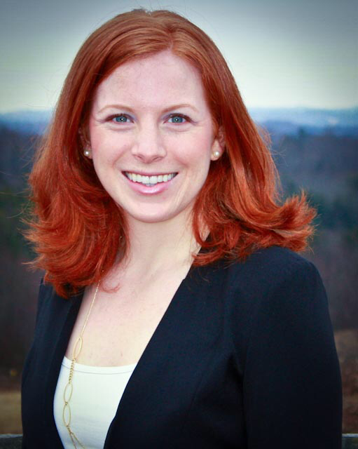
Caroline dawn Wortham
July 14, 1989 –
September 5, 2015
Notes:
Your sons and daughters and loved ones are bicyclers, runners, walkers, drivers, all getting up close and personal with automobiles and their drivers, some of those drivers following a narrow and dangerous path on our roads with poor vision in hand. We, as advocates for our patients and for public health and safety, can help prevent another tragedy like this one, so let's keep this conversation going and make some healthy changes.

